Slide 1
Clustering of Highly Homologous Sequences to Reduce the Size of Large Protein Databases
BIOINFORMATICS,Vol. 17, no. 3 2001, Pages 282–283
Weizhong Li , Lukasz Jaroszewski and Adam Godzik,
Presenter: Mao-Yuan Kao
Date: Nov. 30, 2006

Slide 2
Abstract
We present a fast and flexible program for clustering large protein
databases at different sequence identity levels.
It takes less than 2 h for the all-against-all sequence comparison and
clustering of the non-redundant protein database of over 560 000
sequences on a high-end PC.
The output database, including only the representative sequences, can
be used for more efficient and sensitive database searches.

Slide 3
Non-Redundant
A non-redundant protein database (NR) , where proteins with identical
sequences are combined to single entries

Slide 4
Methods
Sequences are first sorted in order of decreasing length.
The longest one becomes the representative of the first cluster.
Then each remaining sequence is compared to the existing
representatives.
If the similarity with any representative is above a given threshold, it is
included into that cluster. Otherwise a new cluster starts with it as
representative.

Slide 5
Short Word Filters
Short word filters are applied to reduce the number of pairwise
alignments, the most time consuming element of the clustering
procedure.
Two proteins sharing certain sequence identity should have at least a
certain number of identical dipeptides, tripeptides and so on.
For example, two sequences having 85% identical residues over a
100-residue window will have at least 70 identical dipeptides,
55 tripeptides and 25 pentapeptides.
Therefore, pairs of sequences that don’t satisfy these conditions don’t
have to be aligned, which allows speeding up the clustering of the
database.

Slide 6
We introduce a new filtering mechanism based on shorter words
(from 2 to 5 residues) and an index table.
The advantage of short words is that they can be easily indexed.
For pentapeptide, since the total number of them is only 21⁵, (each
residue has 21 possibilities, 20 amino acids plus ‘X’), the index table
requires only 4 million entries.
So an index table with each entry representing a unique pentapeptide
can fit into memory for a PC-based workstation.
In our method, each entry in the index table holds numbers of the
representative sequences containing this pentapeptide.

Slide 7
Implementation
When a new sequence is processed, the short word filter works in the
following steps.
(1) The program finds the types and numbers of pentapeptides the new
sequence has.
(2) In the index table, the entries of these pentapeptides are scanned.
(3) For each old representative sequence, the number of identical
pentapeptides with the new sequence is calculated.
(4) Only if this number is greater than the required value, an alignment is preformed to confirm their sequence identity.
In this way, the filter avoids many unnecessary pairwise alignments.

Slide 8
Using shorter word filters enables the program to cluster databases at
relatively lower thresholds.
The pentapeptide and tetrapeptide filters are efficient for thresholds
above 85 and 80% respectively, tripeptide and dipeptide are valid for
thresholds above 75 and 65% respectively.

Slide 9
The program was written in C++, and was developed on a Linux PC.
The input to the program is a protein database in FASTA format.
The primary output is a FASTA file with representative proteins.
The second output file lists the clusters and their members.
For a large database, the program can divide it into several parts
according to the available memory, and temporary data of each part
can be saved on hard disk. This design allows the calculations to
be done on computers with smaller memory.

Slide 10
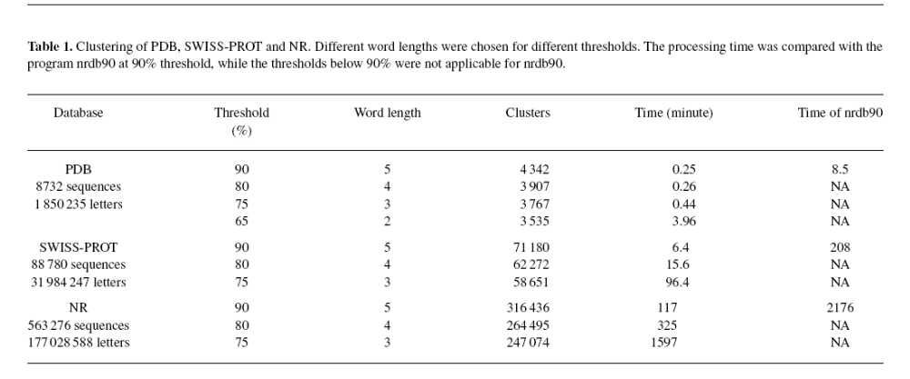
Results
We tested this program on a PC with a 400 MHz PII processor and 512
MB RAM running RedHat Linux 6.1.
The target databases were PDB, SWISS-PROT and NR downloaded
from the NCBI on 20 September, 2000.

Slide 11
Availability
The source code is available from
http://bioinformatics.burnham-inst.org/cd-hi

